Slide 1
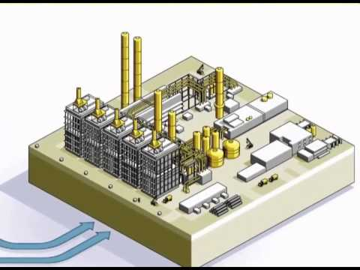

ETHYLENE & IT’S PRODUCTION
By:
Manish Ojha
Courtesy:

Slide 2
What is Ethylene?
Ethylene (C2H4, also known as ethene) is a gaseous organic compound that is the simplest of the alkene chemical structures.
Most commercially produced organic compound in the world and is used in many industrial applications.
Fruit ripening gas – ethylene
Ethene is also used as a plant hormone to control the ripening and colour development of fruit.
Chinese practice of burning incense in closed rooms with stored pears stimulates ripening of the fruit.
The idiom ‘one bad apple spoils the barrel’ is based upon the effect of one apple ripening (or rotting) and emitting ethylene which accelerates the ripening and senescense of apples stored with it.

Slide 3
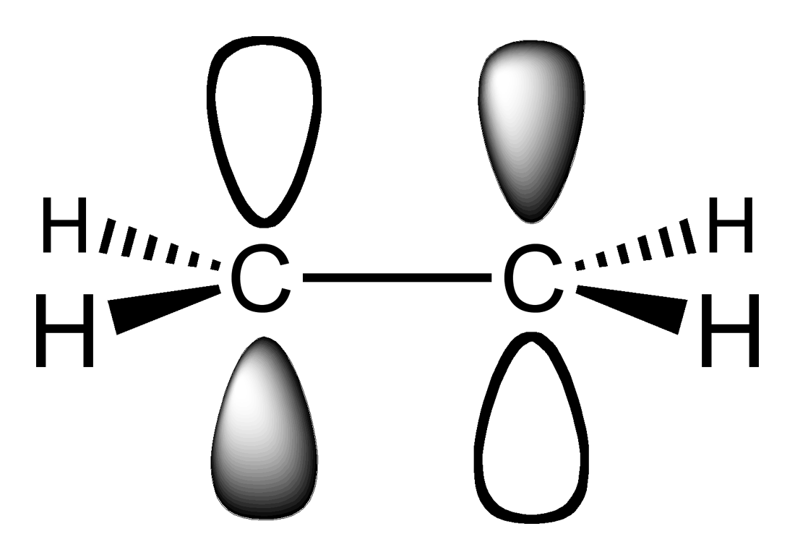
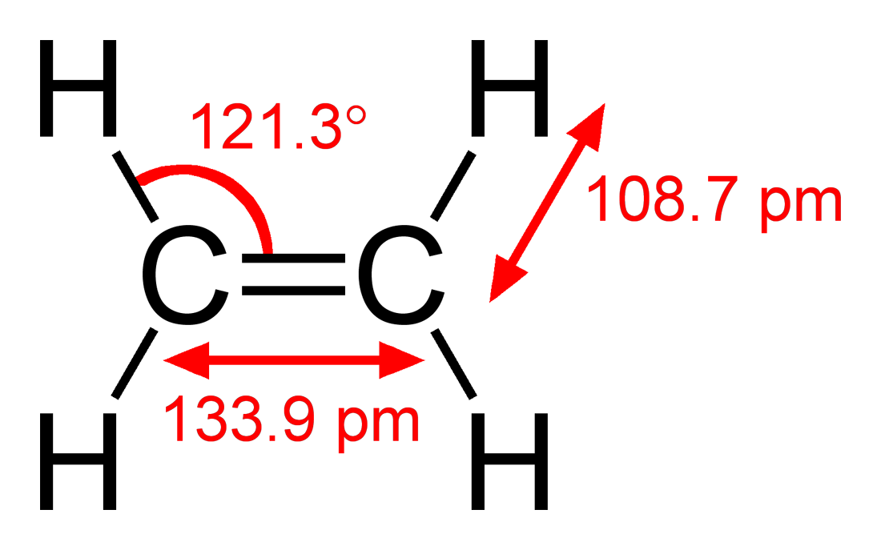
Structure :

Slide 4
Properties of Ethene (ethylene)
Colourless gas at room temperature and pressure Melting point -169ºC Boiling point -104ºC
slightly sweet smell
flammable
non-polar molecule soluble in non-polar solvents & insoluble in polar solvents like water
Reactive: the active site is the double bond Readily undergoes addition reactions, for example reacts with bromine water (red-brown) to produce colourless 1,2-dibromoethane CH₂=CH₂(g) + Br₂(l) -----> CH₂Br-CH₂Br(g)

Slide 5
Physical Properties
Formula | C2H4
Molecular Weight (lb/mol) | 28.05
Critical Temp. (°F) | 49.1
Critical Pressure (psia) | 742.7
Boiling Point (°F) | -154.8
Melting Point (°F) | -272.5
Triple point temperature Triple point pressure Gas Density @ 70°F 1 atm (lb/ft3) | 169.16 °C 0.00122 bar 0.0730
Specific Volume @ 70°F 1 atm (ft3/lb) | 13.70
Specific Gravity | 0.992
Specific Heat @ 70°F (Btu/lbmol-°F) | 10.28

Slide 6
USES
Production of Polythene (polyethylene) | nCH₂=CH₂ | catalyst --------> high pressure | (CH₂-CH₂)n
Production of Industrial Alcohol (ethanol) | CH₂=CH₂ | (1)H₂SO₄ --------> (2)H₂O | CH₃-CH₂OH
Production of 1,2-ethanediol (ethylene glycol) | CH₂=CH₂ | (1)O₂/catalyst --------> (2)H₂O | CH₂OH-CH₂OH
Production of chloroethane chloroethane is used to manufacture tetraethyl lead tetraethyl lead is the lead additive in leaded petrol | CH₂=CH₂ + HCl | -----> | CH₃-CH₂Cl

Slide 7
USES
The global ethylene market is driven by growth in the use of polyethylene; ethylene glycol/oxide for polyethylene terephthalate (PET) resins for PET fiber, bottles and other packaging;
Ethylene dichloride for PVC plastic uses in construction and pipe.
It is extensively used in agriculture as a plant hormone to ripen fruits; it is also used in the chemical industry to produce ethyl benzene, polyethylene, ethylene dichloride, and ethylene oxide among others.

Slide 8
Continued..
On the basis of applications of ethylene, the global ethylene market has been segmented into high density polyethylene (HDPE), low-density polyethylene (LDPE) and linear low density polyethylene (LLDPE).
And intermediates of petrochemicals, mainly used for the production of plastics. The most important of these are ethylene dichloride and ethylbenzene and ethylene oxide.
Furthermore, ethylene is used as a welding gas and as an anaesthetic agent.

Slide 9
ETHYLENE PRODUCTION
Early methods of ethylene production
Ethylene and the sugar industry
Ethylene and the coke ovens
Ethylene from coal
Industrial method

Slide 10
Early methods of ethylene production
The seventeenth century German chemist John Becher prepared impure ethylene from alcohol (ethanol) by dehydrating it with concentrated sulfuric acid.
Later it was discovered that ethylene could also be produced by passing ethanol vapour over red-hot clay.
Further investigations showed that heated silica (SiO2) or heated alumina (Al2O3) also dehydrated ethanol to produce ethylene.
C2H5OH (l) ---------→ C2H4(g) + H2O(g)

Slide 11
Ethylene and the sugar industry
Until 1966, the petrochemical plant at Botany used ethanol from the sugarcane industry to manufacture ethylene.
The ethanol is produced by the fermentation of molasses. One method of dehydrating ethanol is to react it with concentrated sulfuric acid.
Ethylene is still produced by ethanol dehydration in some modern plants. The dehydration of the ethanol is achieved by passing the ethanol vapour over a bed of alumina and phosphoric acid in a reactor. The reaction occurs in two steps, during which an intermediate ‘ether’ is formed:

Slide 12
Ethylene and the coke ovens
When coal is heated in the absence of air (‘destructive distillation’) various volatile materials including ethylene are produced.
Ethylene can also be produced from coke, which is the product of the carbonisation of coal. This process is carried out in coke ovens in the absence of air. About 2% of the coke oven gas is ethylene.
The ethylene can be extracted from the other gases by liquefaction. This source of ethylene was important prior to World War II.

Slide 13
Ethylene from coal
A mixture of carbon monoxide and hydrogen gas is known as synthesis gas. It can be made by heating coal with steam and air.
This synthesis gas can be then converted to a mixture of hydrocarbons, including ethylene, by passing the gas over different catalysts at optimum conditions of temperature and pressure .

Slide 14
Industrial methods used for production of Ethylene
Thermal cracking
Steam cracking

Slide 15
Thermal cracking
Thermal cracking is a refining process in which heat (~800°C) and pressure (~700kPa) is used to break down, rearrange, or combine hydrocarbon molecules.
However, this method produces large amounts of solid and unwanted coke.

Slide 16
Steam Cracking
Steam cracking is carried out at temperatures of 1,500°-1,600° F, and at pressures slightly above atmospheric P.
The feedstock range from ethane to vacuum gas oil, with heavier feeds giving higher yields of by-products such as naptha.

Slide 17
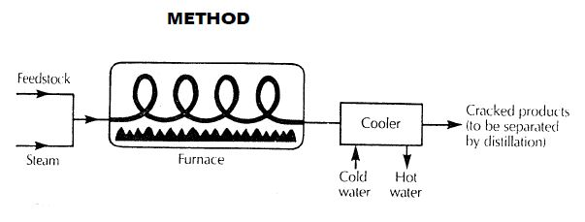
Basic Block Diagram for Production of Ethylene by steam cracking of HYDROCARBONS :

Slide 18
Stages involved :
Feed Cracking
Transfer Line Exchanger
Cracked Gas Processing
Gasoline Fractionator
Quench tower
Compression train

Slide 19
Stages involved continued :
Refrigeration train
De methanizer & De ethanizer
Ethylene fractionator (C2 splitter)
Propylene fractionator (C3 splitter)
De Butanizer

Slide 20
Flow sheet
&
Edraw

Slide 21
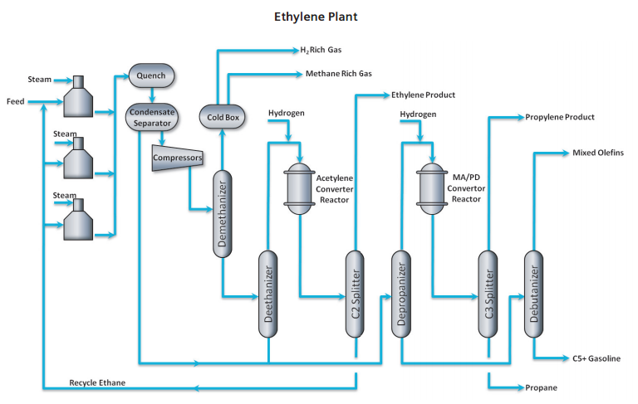
Flow sheet

Slide 22
PFD
Simple Process Flow
Industrial Furnaces
Steam
Heat exchangers
Ethylene
Feed
Propane
Propylene
Compressor
Condenser
Butane, Butene etc.
Quenching Tower
Recycled feed
Feed recycle
Distillation/
Seperation Column
Drew using Edraw

Slide 23
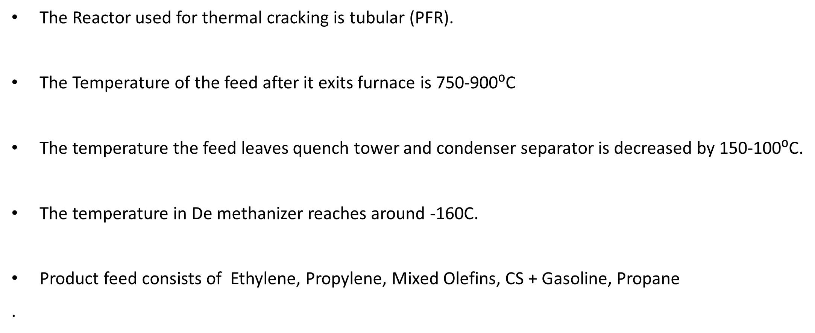
Operating Conditions :

Slide 24
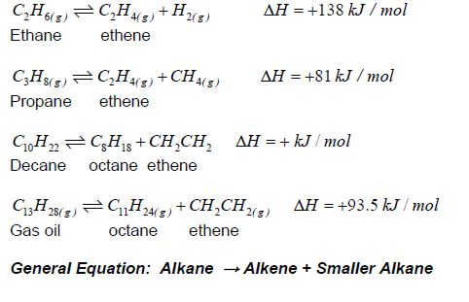
Reactions involved in above process:

Slide 25
Process Description
The bulk of the worldwide production is based on thermal cracking with steam. The process is called pyrolysis or steam cracking.
The first process is using steam to transport a mixture Hydrocarbons to a series of industrial furnaces and heating it to 1500˚F /800˚C, which requires a lot of energy.
At that temperature single bond of the Hydrocarbon(mostly ethane) molecules is loosened to the point that it loses two of the hydrogen atoms.
In addition to ethylene, a number of other molecules are formed, but ethylene is in much greater abundance (about 80 percent) than the other substances

Slide 26
Pyrolysis furnace
The hydrocarbon molecules of the feedstock are cracked in the furnace in the presence of a catalyst at high temperatures.
Typically more than ten furnaces are used in a single ethylene plant.
Most feedstocks are naphta or a mixture of ethane and methane. The feed is mixed (diluted) with steam to minimize the side reaction of forming coke and to improve selectivity to produce ethene.
The fundamental parameters of cracking furnaces are temperature and temperature profile, residence time of the gas during cracking, and partial pressure.

Slide 27
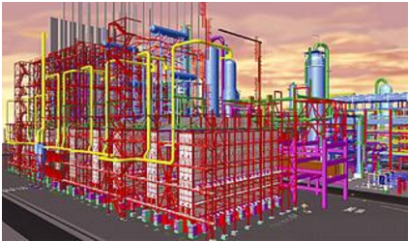
Cracking furnaces
Courtesy: Jam petrochemical, Iran

Slide 28
HEAT EXCHANGER AND QUENCHING TOWER
The next step is sending the mixture of very hot gases (liquids also become gases at that temperature) to a series of heat exchangers that use steam to cool the gaseous mixture.
Once cooled, the mixture of steam and gases go to a tower where cold water is poured onto it from above to force all the different liquids to the bottom. These liquids are usually hydrocarbons with more than five carbon atoms. This process is also called quenching and the tower is referred to as a quenching tower.

Slide 29
Two separate product streams come out of the quenching tower. One product stream is water and a mixture of heavier hydrocarbons commonly referred to as pyrolysis gasoline.
The water is cleaned and recycled back into the quench tower. The pyrolysis gasoline is sent to another separation unit for for further use.

Slide 30
COMPRESSOR
Compression train : The gas from the quench tower is then compressed in a 4 or 5 stage compressor train to an optimum pressure for separating it into various components.
Water and hydrocarbons are separated between stages and recycled. Acid gases (CO2 and H2S) are removed after the 3rd or 4th compression stage by scrubbing them with a dilute causic soda solution.
In case of higher sulfur content a separate gas removal system is used.

Slide 31
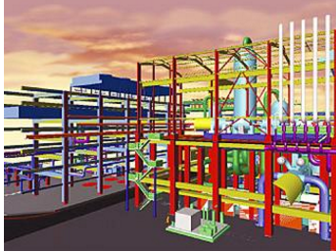
Compressors groups
Courtesy: Jam petrochemical, Iran

Slide 32
Refrigeration train : The pyrolysis gas is then partially condensed over the stages of a refrigeration system to about -165 °C .
Demethanizer : The DeMethanizer is designed for complete separation of methane from ethylene and heavier components
Deethanizer : The DeEthanizer produces C2 hydrocarbons as overhead (acetylene, ethane and ethylene) and C3 and heavier hydrocarbons as bottoms.

Slide 33
Distillation/Separation Column
The gases are liquefied, the mixture goes through a series of tall towers called distillation units that are precisely controlled for temperature. Since liquefied gases boil (turn back into gases) at different temperatures, the distillation towers can control the isolation and removal of specific gases during this process.
Ethylene produced is then usually transported by a special dedicated pipeline to other industrial facilities to make a variety of products called ethylene derivatives.

Slide 34
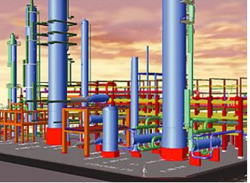
Separation towers
Courtesy: Jam petrochemical, Iran

Slide 35
Storage Tank
PROCESS EQUIPMENTS
To store feed before usage in drums.
Improper storage may lead to spill, evaporation, or seep through small openings.
Pressure relief valves needed to keep the containers from rupturing during a fire.
Accessories like safety fittings, valves, pipelines, Excess flow valves, internal valves required
Manufacturers: BNH tanks, Dow, Houston PolyTank LLC

Slide 36
2. Pre heater
The feed is preheated to the reaction temperature in a fired heater.
in our case reaction temperature is about 700 to 800 celsius.
Manufacturer: Foster Wheeler
Courtesy:

Slide 37
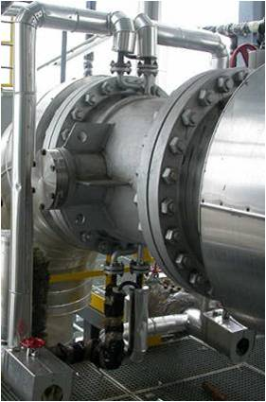

3. Steam cracker/Cracking heater
Initially a CSTR was used. Too much coke formation was observed.
A fluidized bed reactor was proposed in order to increase available surface area and mixing.
Counter current cooling must be provided.
Latest model(1999) proposed by Dow Chemicals: a tubular reactor zone attached to the spherical, egg-shaped or oval reactor zone
Manufacturer: CPMAI, Toyo, Technip
Courtesy :

Slide 38
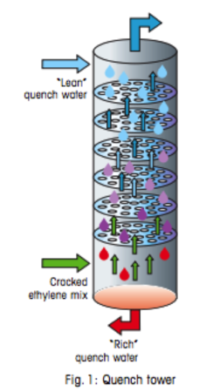
4. Quenching Tower
The mixture of steam and gases go to the quenching tower where cold water is poured onto it from above to force all the different liquids to the bottom.
Manufacturer: CPMAI, Toyo, Technip
Courtesy :

Slide 39
5. Separation system
The unreacted raw material and other hydrocarbons are separated in the separation system.
Manufacturer: CPMAI, Toyo,Indiamart, Technip.
Courtesy:

Slide 40
Raw Materials used in the Production
The most common feedstocks, or raw materials, are naphtha and light gas oil, which are derived from the oil refining process, and individual gases such as ethane, propane and butane, which come from a complex mixture of hydrocarbons known as natural gas liquids, or NGLs.
Primary Sources : Fossil fuel, Natural gas and fossil fuel emissions.

Slide 41
Raw Materials used in the Production
Extraction from natural gas using fractional distillation followed by steam cracking (the technique for converting alkanes to alkenes)(750 - 900ºC) followed by liquefaction of the gas (-100ºC) and then further fractional distillation .

Slide 42
Raw Materials continued…
Extraction from crude oil using fractional distillation followed by steam cracking (750 - 900ºC) of the naphtha or gas-oil fractions followed by liquefaction of the gas (-100ºC) and then further fractional distillation.

Slide 43
How to Improve production?
By Major energy improvements by Increased thermal efficiency
Higher radiant efficiency and less excess air by new burner technology and better instrumentation
Reduced heat losses due to fewer and bigger furnace units or new refractory
Higher yields by new radiant coils, reducing specific energy demand
Higher availability by application of new and highly reliable technology, reducing losses due to unplanned shutdowns.

Slide 44
Improving production
Performance of the steam cracking furnace can be upgraded by:
(i) increasing furnace capacity
(ii) increasing cracking severity
(iii) improving ethylene selectivity
(iv) improving thermal efficiency
(v) reducing downtime for decoking and hence reducing maintenance

Slide 45
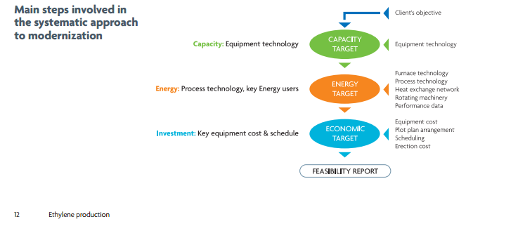
Courtesy: Technip

Slide 46
Environmental issues in ethylene production
The main issues to be considered in the production of ethylene are:
• Reducing the use of fossil fuels and the associated release of greenhouse gases such as carbon dioxide; this can be achieved by cracking ethane from LPG rather than cracking naphtha.
• Reducing water usage (used for heating or cooling) by recycling.
Pollution control Board reports that No person shall emit into the atmosphere a waste gas stream from any ethylene producing plant unless the waste gas stream is subjected to 1,300˚F for 0.3 seconds or greater in a direct-flame afterburner or equally effective catalytic vapor incinerator. Either device must be equipped with an indicating pyrometer which is positioned in the working area at the operator's eye level.

Slide 47
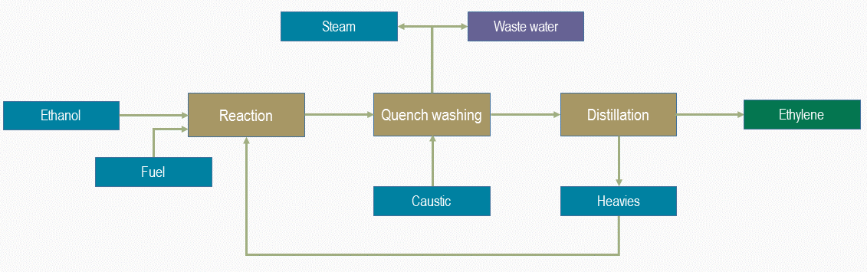
BIO ETHYLENE
Raw material : Bio ethanol feed with Syndol catalyst.
Courtesy: Chematur engineering

Slide 48
Major Ethylene Plants Worldwide
Yansab KSA: the world’s largest steam cracker with a capacity of 1.7 Mtpa at term using ethane and propane feedstocks.
Rabigh KSA: the world's largest ethane cracker, operating at 1.5 Mtpa
RasLaffan, Qatar: Large ethylene plant with a capacity of 1.3 Mtpa based on ethane cracking,
Jamnagar, India: the world’s largest cracker based on refinery off-gases under design, which will produce 1.4 Mtpa of ethylene.
Sasol Lake Charles, Louisiana: design of an ethane cracker with a production capacity of 1.5 Mtpa worth of ethylene
DOW - LHC9, Freeport, Texas: design of an ethane cracker with a production capacity of 1.5 Mtpa worth of ethylene

Slide 49
LyondellBasell, Dow Chemical Co., ExxonMobil, ChevronPhillips, Shell and Ineos, National Petrochemical Co., BASF, Fina Petrochemicals, Formosa, Sabic, Sinopec, Total AS, Westlake Petrochemicals and Reliance Industries Ltd are some of the leading producers of Ethylene.

Slide 50
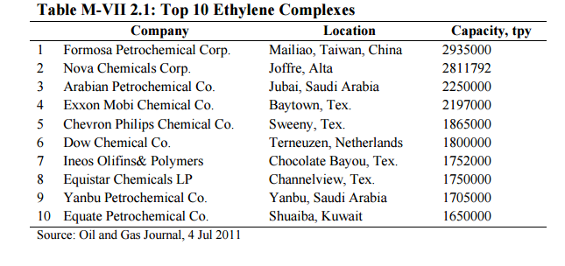

Slide 51
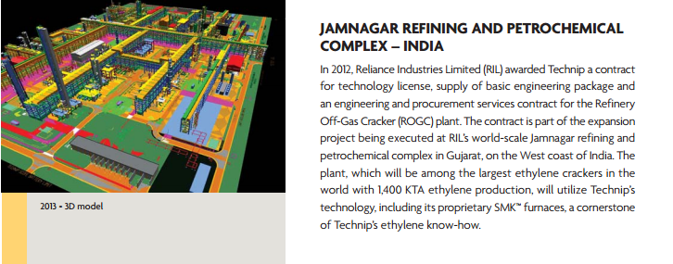
Courtesy: Technip

Slide 52
Indian Market Survey for Ethylene

Slide 53
The worldwide production (over 109 million tonnes in 2008) exceeds that of any other compound.
And India accounts for 9 percent of this total Ethylene capacity.
Cost of ethylene as per USA market 1172$/ton
The leading players in the Indian ethylene industry are Reliance Industries, Indian Oil Corporation, Haldia Petrochemicals, and GAIL India Limited. (2010 data)

Slide 54
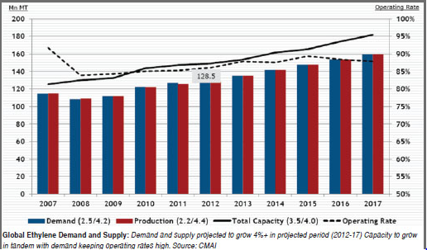
Supply and Demand of Ethylene in India:
Courtesy: Reliance Industries Limited(RIL)

Slide 55
TECHNOLOGICAL ROADMAP
One of the first patents for the commercial production of ethylene is creditedto Union Carbide in 1922. Just three years later, the first commercial plant for ethyleneproduct was built in West Virginia in the United States.Since then, the olefins industry has gradually evolved. Starting with “worldscale” ethylene plants in the early 1950’s with capacities of around 20,000 to 50,000 MTY, plants have become bigger, more energy efficient, and more environmentally friendly.
The nameplate capacity for today’s worldscale crackers can well be over 1,000,000 MTY of ethylene. Naphtha is the predominate feed for steam crackers, followed by ethane, propane, gas oil, Butane and others.

Slide 56
TECHNOLOGICAL ROADMAP
From the late 1960s through the 1970, the petrochemical industry built a generation of new steam crackers with an ethylene capacity of several million tonnes capacity. Older plant consists of typically 10-17 small furnaces with radiant coils having residence time 0.4-0.6 sec, thermal efficiency below 90percent, central waste heat recovery system and nitrogen oxide (NOX) emissions 75-100 ppm.
Present day olefin plants have capacity more than 1,000,000 tonnes per year ethylene produced with 5-7 modern cracking furnaces using twin-cell designs. Short residence time and radiant coil smaller diameters increase yields. The higher selectivity of modern coils reduces specific energy consumption. The modern olefin plants have better ethylene selectivity and improved health, safety and environment standards by incorporating current emission and safety standards.
Today the Asian region, including Southeast Asia, Northeast Asia and the Indian Subcontinent, accounts for an estimated 45 percent of the global ethylene equivalent consumption contained in derivatives.

Slide 57
Global ethylene capacity was 147.4MMT in 2011 against a demand of 120 MMT. The capacity is expected to increase to 165 MMT in 2015 with demand reaching 151 MMT.
Westlake, Ineos, Chevron Phillips, Dow, Equistar, Oxychem, Formosa, Shell, Nova, Braskem/Idesa, Williams, Borouge, and CPC Corp. -Taiwan are some of the companies which announced ethylene capacity expansion plans starting 2012 to 2017.
In India total ethylene capacity is expected to reach 7087 KTA by 2016-17 and Reliance Industries Ltd has planned capacity expansion to 3240 KTA by 2016-17 followed by ONGC OPAL at 1100 KTA, GAIL 1000 KTA, IOC at 857 KTA, HALDIA 670 KTA and BPCL Assam GC 220 KTA.

Slide 58
Future scope
Global ethylene consumption is expected to almost double by 2025.
That expansion, according to a worldwide petrochemical feedstock study by Chemical Market Associates Inc., Dallas, is due to rapid demand growth in Asia.
The study foresees an average growth rate of about 4.8%/year during the next 10 years, slowing to 3.7%/year in the 10-year period after that.
The companies conclude that naphtha will maintain its role as the dominant ethylene feedstock- accounting 50-55% of ethylene produced-with considerable variations among countries and regions.
Ethylene growth will outpace growth in natural gas liquids supply, so heavy liquids will be needed.
Increasing volumes of ethane will be used for future ethylene production, but the potential supply of ethane greatly exceeds current ethane recovery rates, the study notes.

Slide 59
Glossary
Quenching : To cool suddenly by plunging into a liquid, as in tempering steel by immersion in water.
PVC : Poly vinyl chloride
Naptha : Flammable liquid hydrocarbon mixtures.
Destructive distillation :Decomposition of Organic materials by heating it to a high temperature in absence of air and in presence of some catalyst/solvent.

Slide 60
References
http://www.plasticsnews.com/article/20151201/NEWS/151209976/speaker-india-needs-massive-growth-in-ethylene-capacity
http://cpmaindia.com/ethylene_about.php
http://www.researchandmarkets.com/reports/1882235/ethylene_industry_in_india
http://www.process-worldwide.com/india-accounts-for-9-percent-of-total-ethylene-capacity-in-asia-pacific-a-402571/
http://www.toyo-eng.com/jp/en/company/
https://www3.epa.gov/region4/air/sips/ky/lou/
http://cpcb.nic.in
http://www.ogj.com/articles/print/volume-102/issue-3/processing/large-ethylene-plants-present-unique-design-construction-challenges.html
http://chematur.se/process-areas/bio-chemicals/bio-ethylene-ethene/
https://www.irena.org/DocumentDownloads/Publications/IRENA-ETSAP%20Tech%20Brief%20I13%20Production_of_Bio-ethylene.pdf
http://www.technip.com/sites/default/files/technip/publications/attachments/Ethylene
http://www.exxonmobil.com/UK-English/about_what_chemicals_fife.aspx
https://pubchem.ncbi.nlm.nih.gov/compound/Ethene#section=Physical-Description
http://www.frontlineservices.com.au/Frontline_Services/Fruit_ripening_gas_-_ethylene.html
https://pages.wustl.edu/ipgsa/ethylene
http://pubs.acs.org/doi/abs/10.1021/ba-1971-0103.ch009

Slide 61
Thank You !

